Slide 1
Web-based Traffic Violation Record System for Metropolitan Traffic Police
Summer Project Proposal Demonstration
Submitted by:
Bibesh Manandhar
Roll No. 4780
Batch (2013-2017)
Submitted to:
Asian School of Management and Technology
Tribhuvan University
Gongabu, Kathmandu
Under the Supervision of:
Mr. Surya Bahadur Bam
Program Coordinator
Asian School of Management and Technology

Slide 2
Contents
Introduction
Statement of Problems
Limitations
Objectives
Literature Review
Research Methodology
Working Schedule
References

Slide 3
Introduction
Metropolitan Traffic Police Division was introduced in Kathmandu valley in 2063 B.S.
Before the establishment of Metropolitan Traffic Police, the division was known as Valley Traffic Police.
Till date, this division has been working only in the 3 major cities i.e. Kathmandu, Lalitpur and Bhaktapur.
The organization has been implementing the Information Technology since the introduction of Computerized Record System in 2051 B.S. in this organization [1].
Since then, the organization has been completely based on computers and different new technologies like CC Cameras, Breathe Analyzer, go pro camera etc. and all the records has been saved using the computerized system.

Slide 4
Introduction
Different types of technologies have been used in the organization.
Different software and hardware has been used since the computerization took place.
Software like Traffic Violation Record System, Traffic Nepal etc. are being used.
Traffic Violation Record System is the application used by the Traffic police since the establishment of Computerized Record System in 2051 B.S.
It is a desktop based application the is created using Oracle.
The system takes the type of violation and the amount of penalty is printed with the bill and data is saved into the Oracle database.

Slide 5
Introduction
The proposed system is the advance form of the old desktop based system.
This proposed system is applied to convert the old desktop based application into the web based applications as Web applications are popular due to the ubiquity of web browsers.
The convenience of using a web browser as a client to update and maintain web applications without distributing and installing software on potentially thousands of client computers is a key reason for their popularity, as is the inherent support for cross-platform compatibility [2].
The new system can be useful for using the application from anywhere in any devices.

Slide 6
Statement of Problems
Traffic Violation Record System records the information about the drivers who violate the rules.
Violation includes over weighted driving, drink and drive, driver without papers etc.
The penalty / fines is automatically generated by the computer system according to the type of violation this is submitted in the main form by the user.
The record is stored into the database.
After the driver pays penalty, the papers are returned to the driver and information is saved into the database.

Slide 7
Limitations
Some of the limitation of current applications are:
Application cannot be used in the mobile or from the browser.
Application requires its own intranet.
Application used in the intranet rather than internet.
Desktop based system.

Slide 8
Objectives
General Objective
The basic purpose of this study is to information about the use of Compute based application in this organization.
Specific Objective
The specific objective of this study are mentioned below:
Changing the desktop based application to mobile and web based application
Problems in the software used in organization
Completing the future plans of the organization

Slide 9
Literature Review
According to Hantu (2011), “In the Democratic Republic of the Congo five automatic traffic police are in operation. The large aluminum figures are able to rotate at the waist, and contain closed circuit television cameras to allow them to record offenders, for later apprehension or imposition of fines.” [3]
According to article in State of new jersey website, “Closed circuit television is designed and built by a women’s engineering co-operative in DRC. Another five robots have been bought for Katanga Province, and a further thirty for motorway use have been proposed.”

Slide 10
Literature Review
According to Nourdine Aliane, Javier Fernández, Sergio Bemposta and Mario Mata “Traffic violation alert and management software architecture is organized into two modules: namely, the traffic sign detection and recognition (TSDR) and the traffic violation management(TVM). The TSDR module is used to detect vertical signs present along the road and is aimed at alerting drivers in certain dangerous situations, such as “Speeding”, “No Passing Zone”, “Intersections”, “Stop Signs”, “Yield Signs”, “Dangerous Turns”, “Steep Slopes”, or “Road Works”. On the other side, the TVM module is intended to manage traffic violations when they take place. At present, this module is focused only on three signs: namely, “Speed Limit”, “Stop Sign”, and “Forbidden Turning”.”

Slide 11
Research Methodology
Data Collection
Online publication research
For preparing this report many online news articles, journals and other related websites related to traffic violation record system were reviewed.
Reading these articles, journals and websites, important information about what a traffic violation record system does, how it is important to an organization like traffic police.
Direct Interviews
This research is based on interview taken in Metropolitan Traffic Police.
A direct personal interview with Er. Amrendra Prasad Singh, inspector of Metropolitan Traffic Police, was conducted based on questionnaire to gather information.

Slide 12
Research Methodology
Questionnaire:
Does the organization use any kind of computer system or not?
What kind of software is being used?
Before implementing software, what was used to record the system?
What are the drawbacks of the system?
What are the future plans of the system?

Slide 13
Research Methodology
Work process observation
Close observation of the work process of the organization related to Traffic Violation Record System was done.
It has given many ideas about how the system works.

Slide 14
Research Methodology
Entry Violation type
Enter violation type
Automatic generate penalty
Store into database

Slide 15
Research Methodology
Update records
Enter chit no. & bank voucher no.
Check violation type
Req. Class?
Class
Return Papers
Store into database

Slide 16
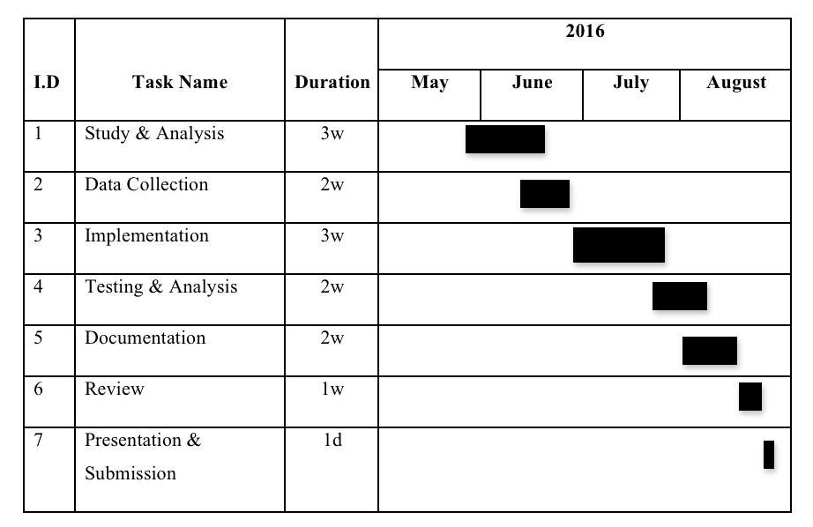
Working Schedule

Slide 17
References
https://traffic.nepalpolice.gov.np/index.php/about-us/history 06/07/2016
https://en.wikipedia.org/wiki/Web_application (Hantu,2011) 06/07/2016
https://en.m.wikipedia.org/wiki/Traffic_police 06/07/2016
http://www.state.nj.us/mvc/Violations/penalties.htm 06/07/2016
2011 14th International IEEE Conference on Intelligent Transportation Systems Washington, DC, USA. October 5-7, 2011

Slide 18
Thank you !!

Slide 19
The End

